Slide 1

Movie theater Ticket Sales system
Elaboration phase
ICS 370- Software Design Models - Ismail Bile
Sala Chang, SAMIR Mahamed, Samantha Schug

Slide 2
Table of contents
Vision
Scope
Domain
Class Diagram
Use Cases
Software Architecture Document
Software Design Document
Actor Scenarios Class Code
UI Prototypes

Slide 3
Vision
The purpose of this project is to provide a tool that will allow analytics of ticket sales for a small theatre to aid management in decision making regarding:
•Staffing
•Marketing
•Promotions
•Pricing

Slide 4
Scope
In Scope
Intended Audience
Movie Theatre
Small (Five screens or less)
Management Only
Intended Use
Data Analytics On Ticket Sales:
Timeframe
Year, Season, Month, Day, Week, Promotional Period
Genre
Comedy, Horror, Romance, Documentary, Action, Science Fiction, Super Hero
Out of Scope
Audiences
Other Businesses
Customers
Entry Level Employees
Large Theatres
Other Uses
Concession Sales
Ticket sales data from other theatres

Slide 5
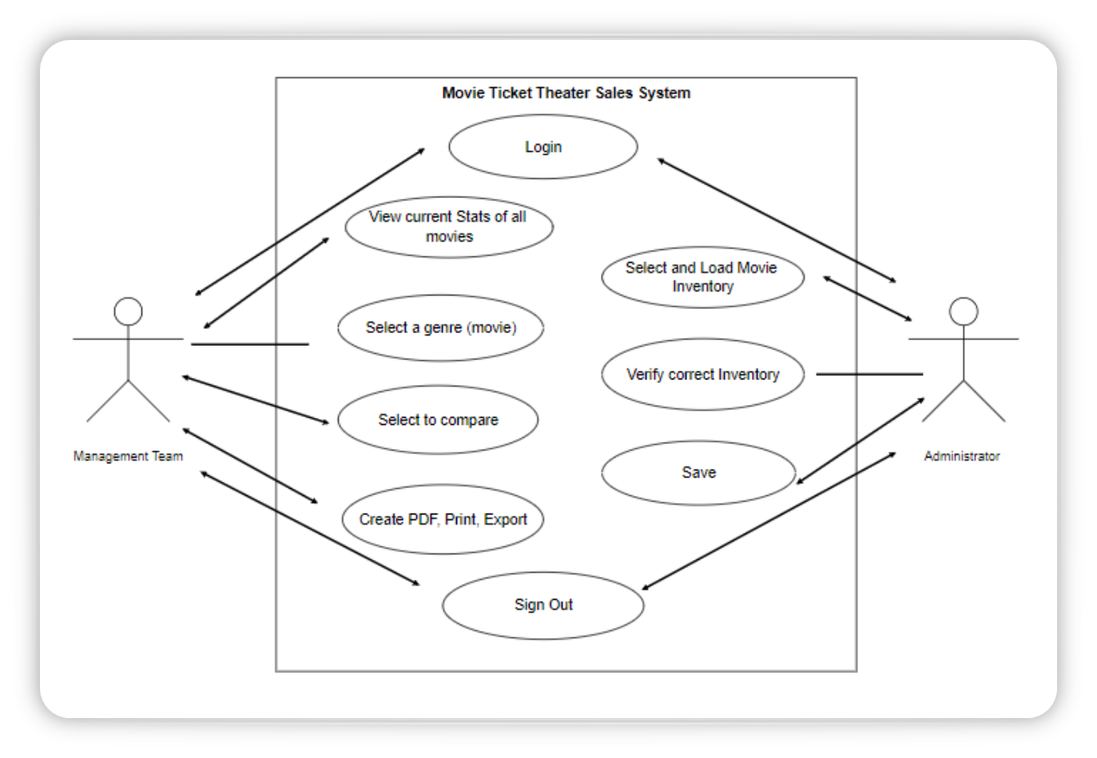
Use Case DIagram

Slide 6
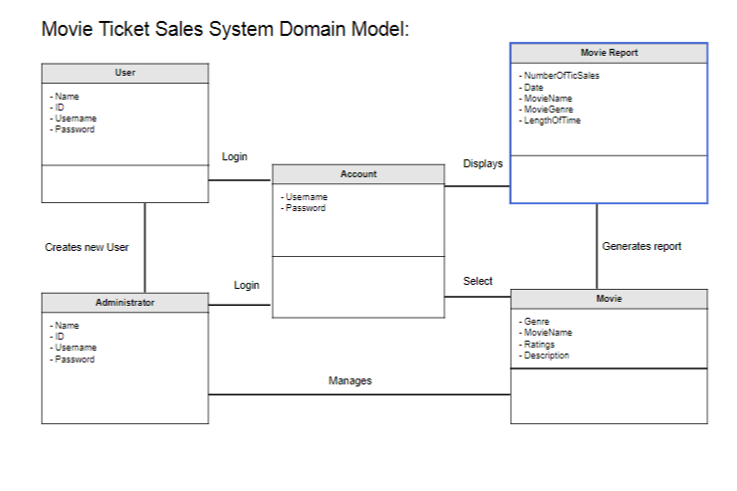
Domain

Slide 7
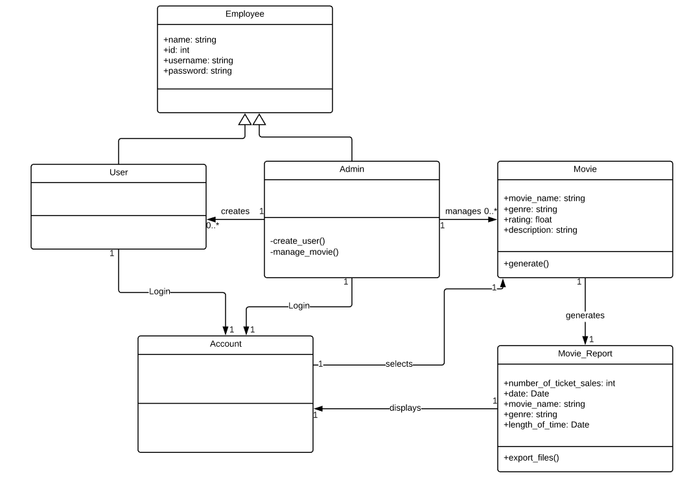
Class Diagram

Slide 8
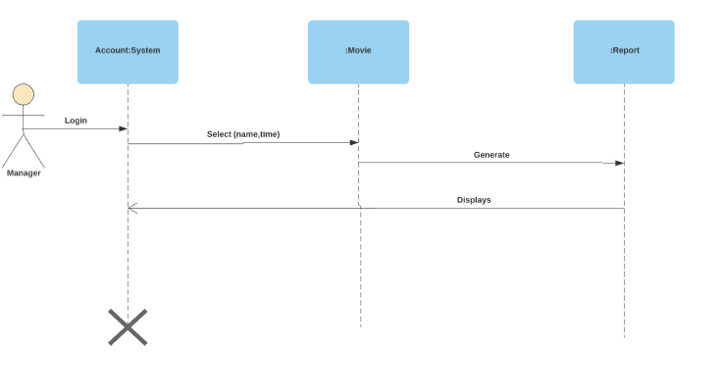
Manager Use case

Slide 9
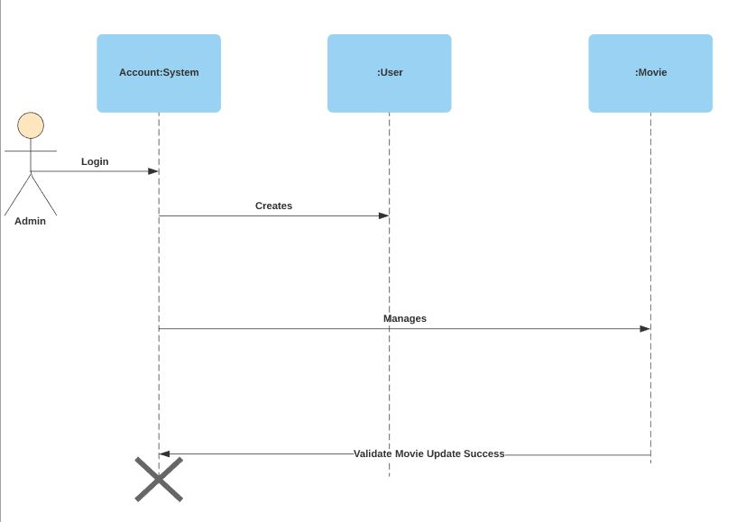
Admin use case

Slide 10
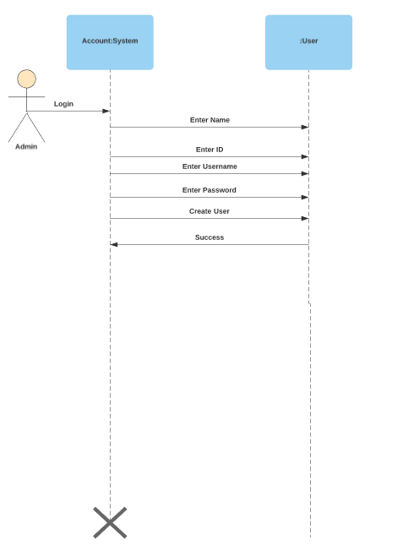
Create user use case

Slide 11
Software Architecture Document...
1. Introduction
1.1 Vision
1.2 Scope
2. Architectural Representation
Use case view
Logical view
Process view
Deployment view

Slide 12
...Software Architecture Document
3. Goals and Constraints
The program will be able to handle several filters in order to provide the accurate and useful information to the user.
Making sure all the information that is stored is updated and reliable.
Having the service online during business hours and making sure there are no inconveniences to the user.
4. Logical View: The movie data system is split into 2 parts
User Interface: This is where an employee or user can enter and receive information by communicating with the interface to access data stored within.
Business Services: The information is able to be controlled as the information can be edited by an administrator, as well as the ability to control user permissions and creation of users.

Slide 13
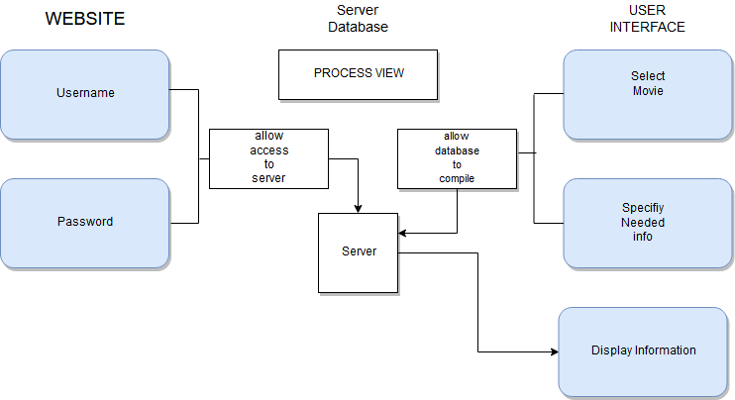
Software Design document
5. Process View: A description of the how the tasks are handled when executed and how they interact.

Slide 14
Software Design document continued
Programming View:
HTML, CSS, and JavaScript will be the technologies that will be used to create the code for this software. Only approved employees can login and receive the information they need from a database.

Slide 15
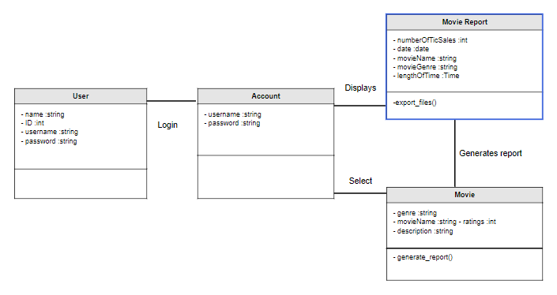
Manager Actor scenarios / class Code:
Manager Actor Use cases scenario modeling:
User signs in to retrieve information on movie. Given 3 options.
This case:
Select to Compare Movies - Select Genre - Select Movie. Select another Genre – Select another Movie - Select length of time to view ticket sales - Select Action (generate report displays on system)– and Return to Home.

Slide 16
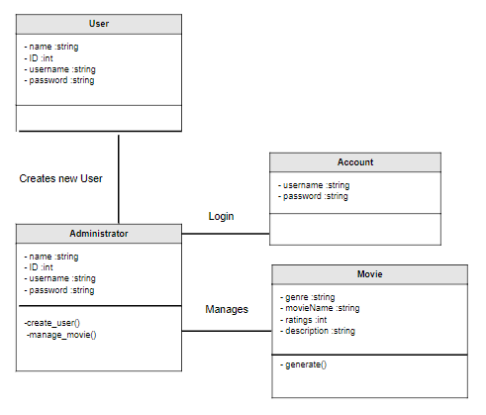
Administrator Actor scenarios / Class Code
Admin use case: Signs in to create new user account:
Creates new user - Involves entering a user's First and Last Name, Username, and password.
2 options available

Slide 17
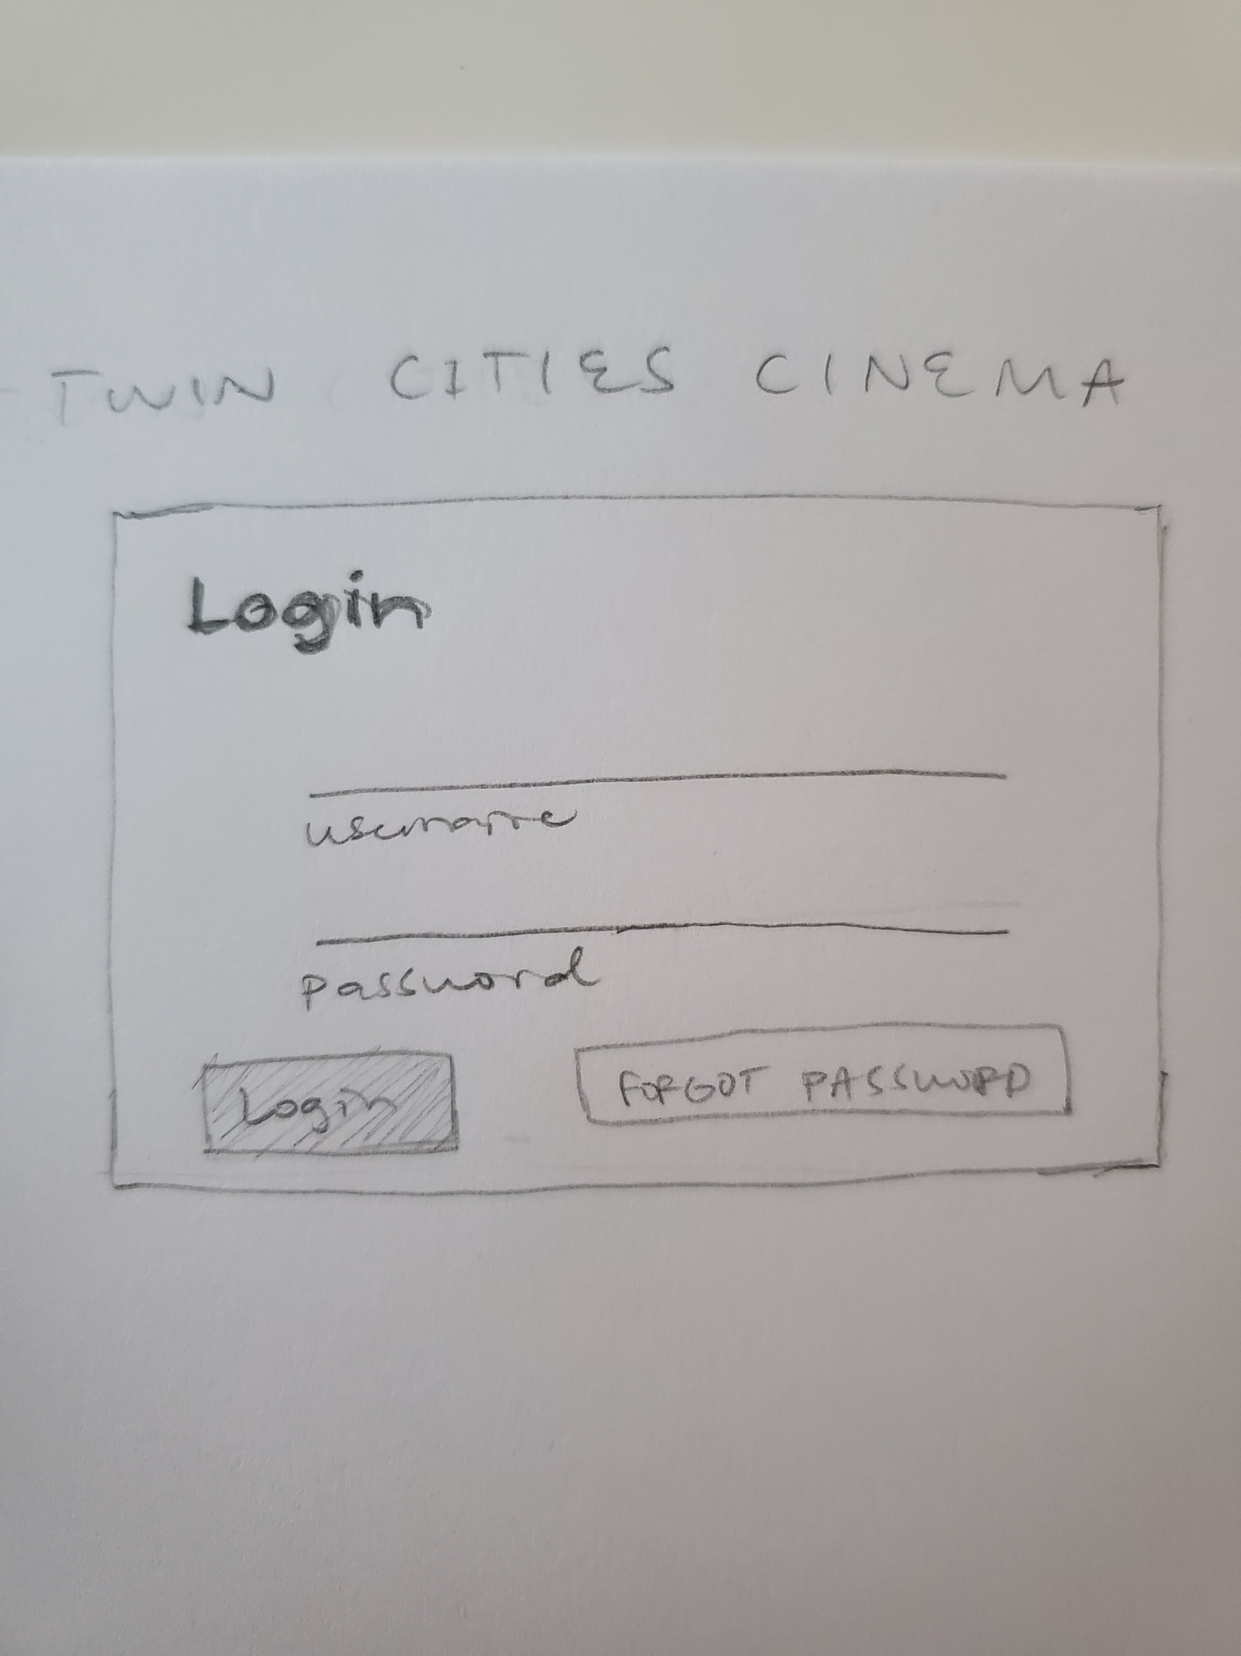
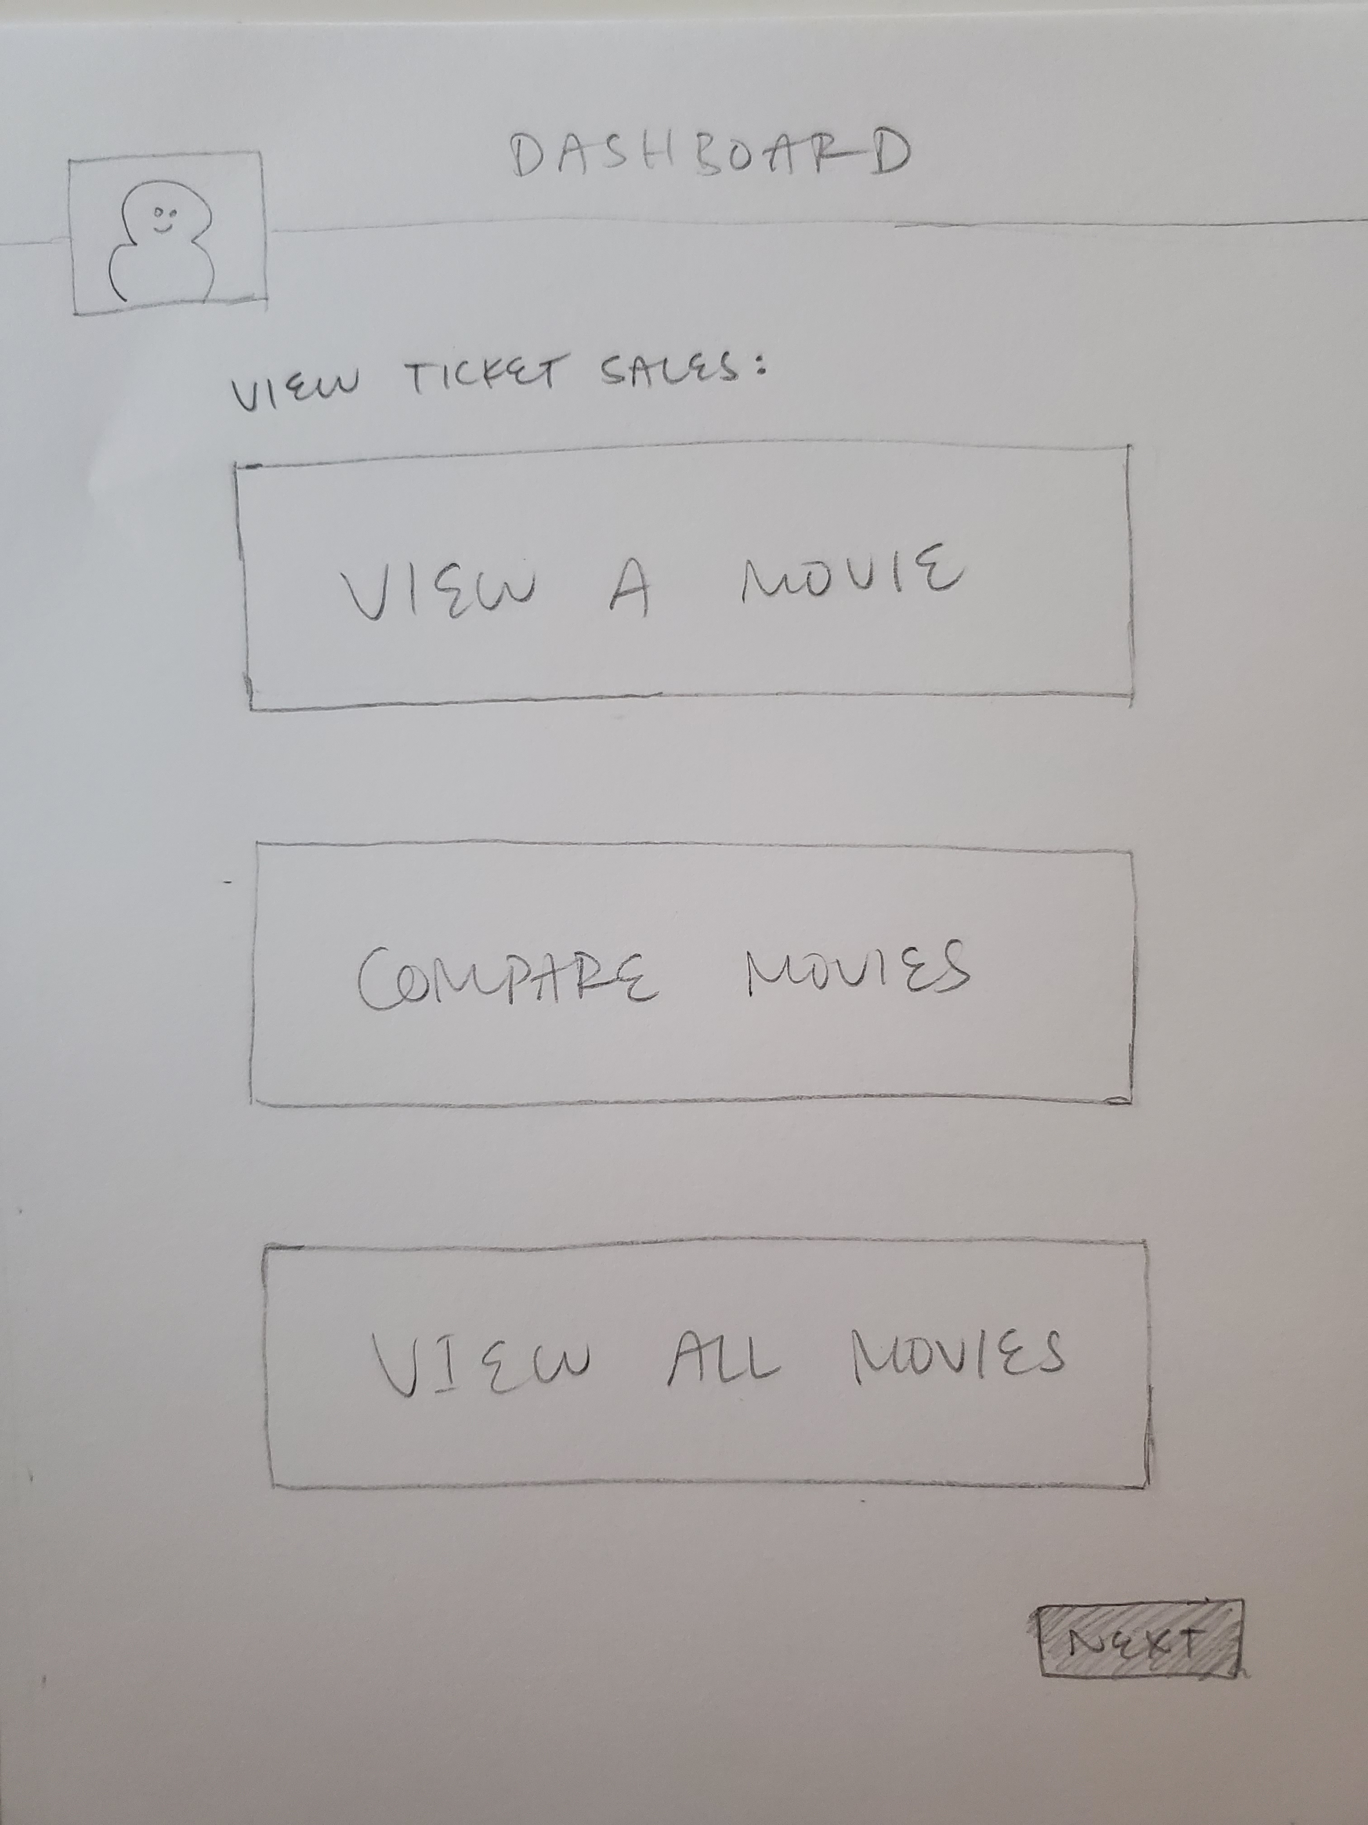
Prototype of User interface
Login
Select one

Slide 18
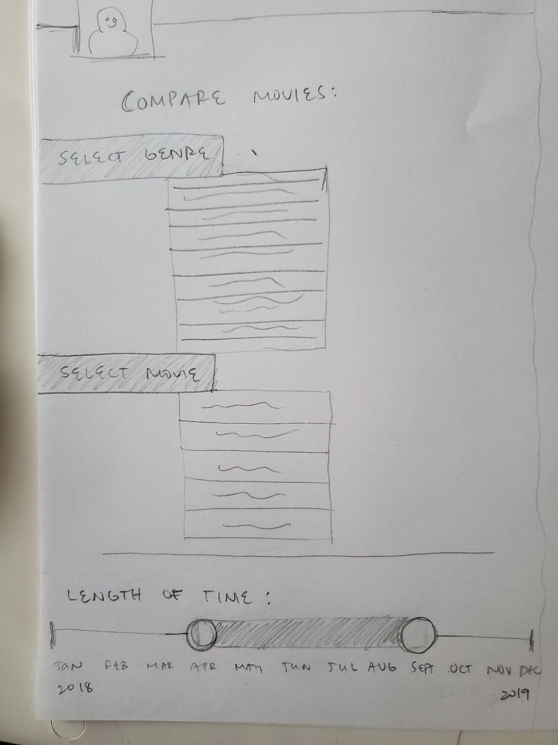
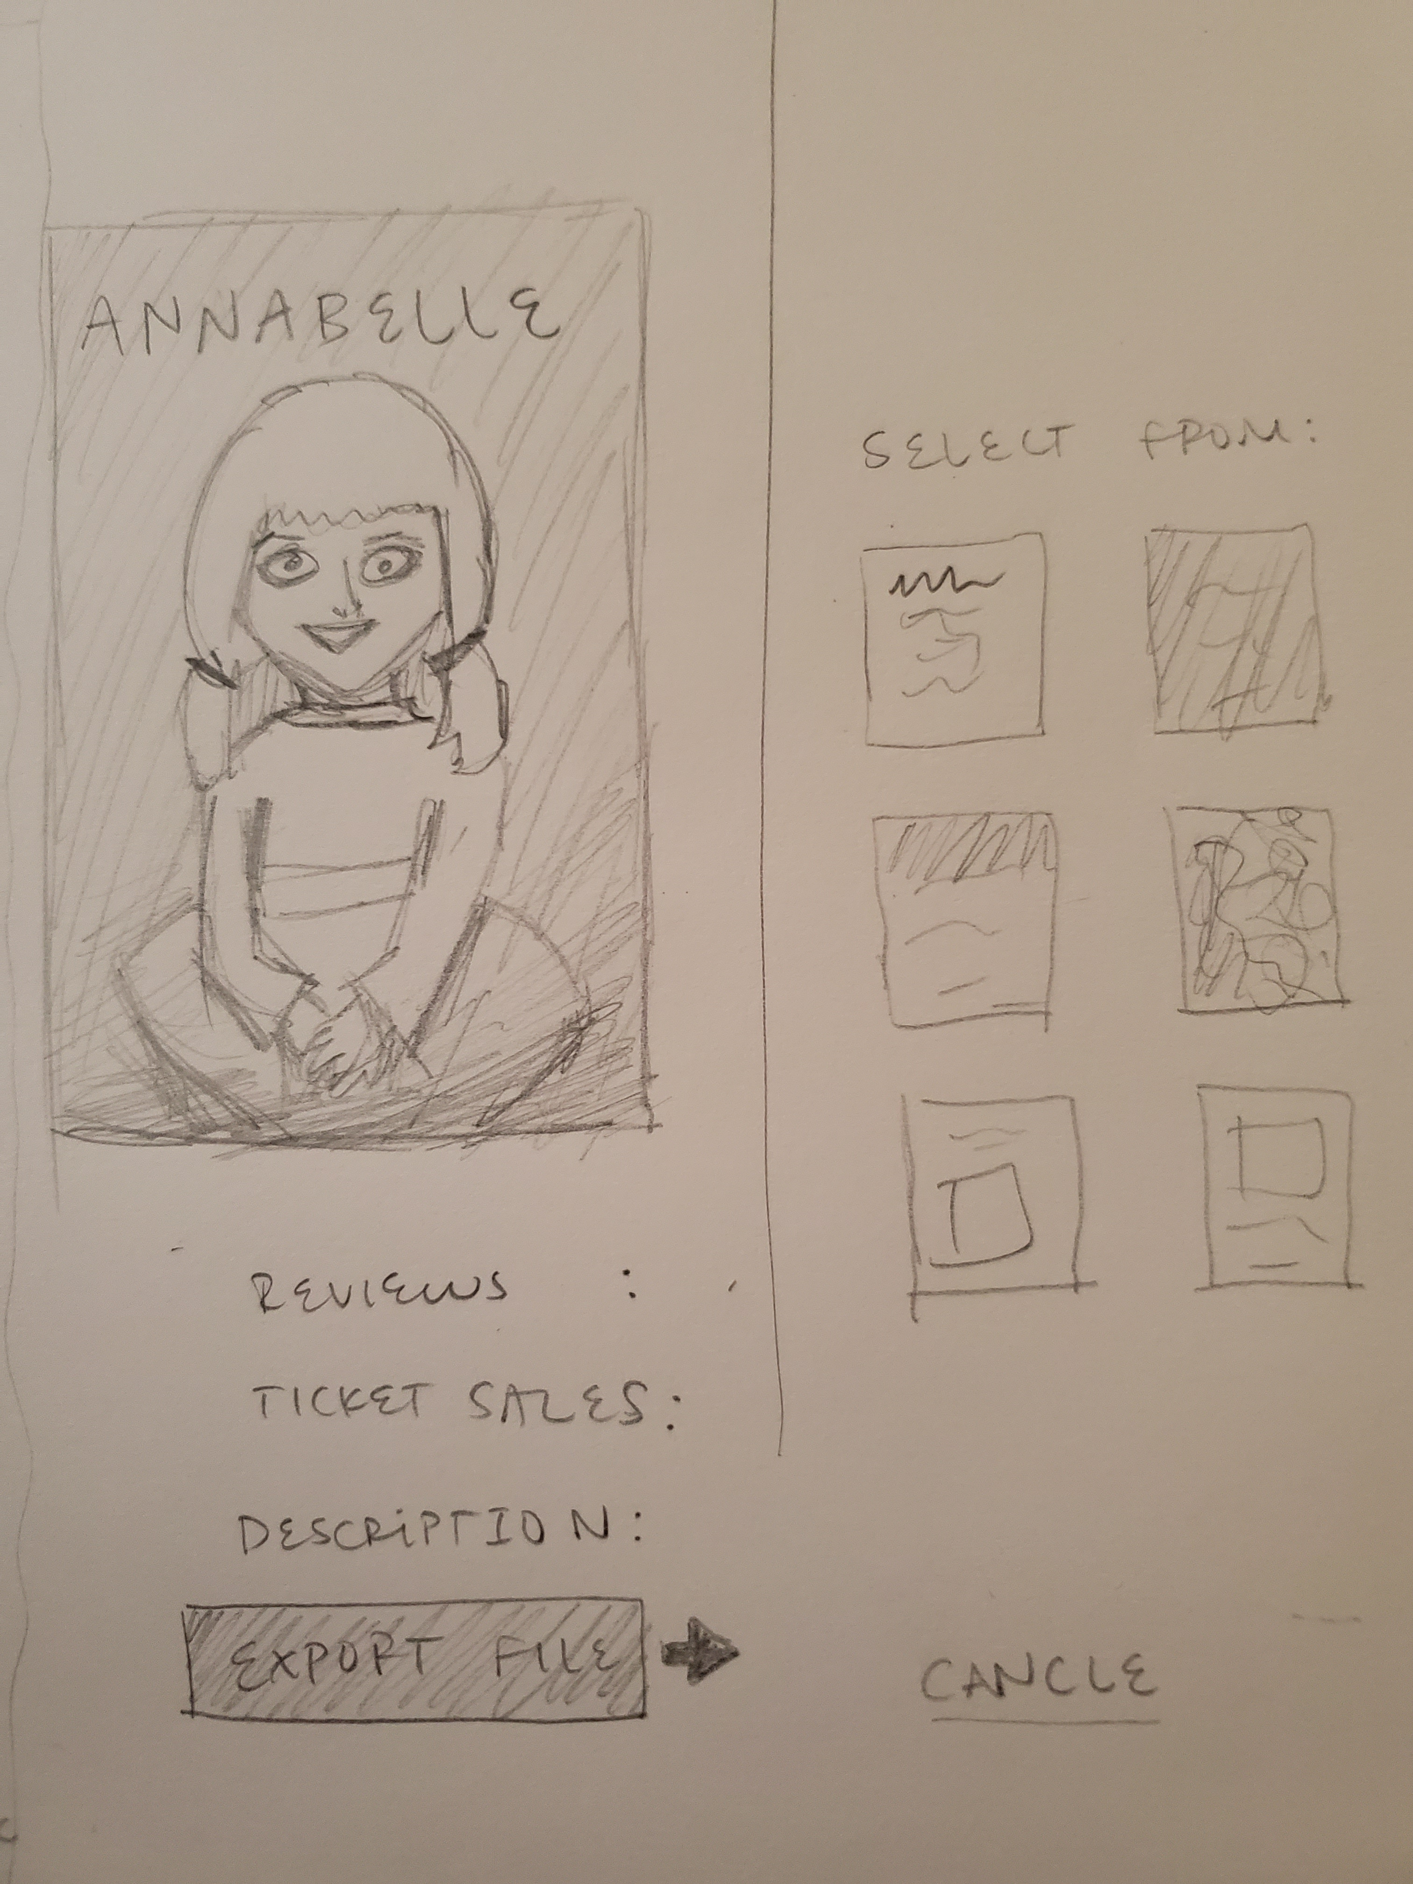
Prototype of User interface
Select Genre & Movie
View Movie Info

Slide 19
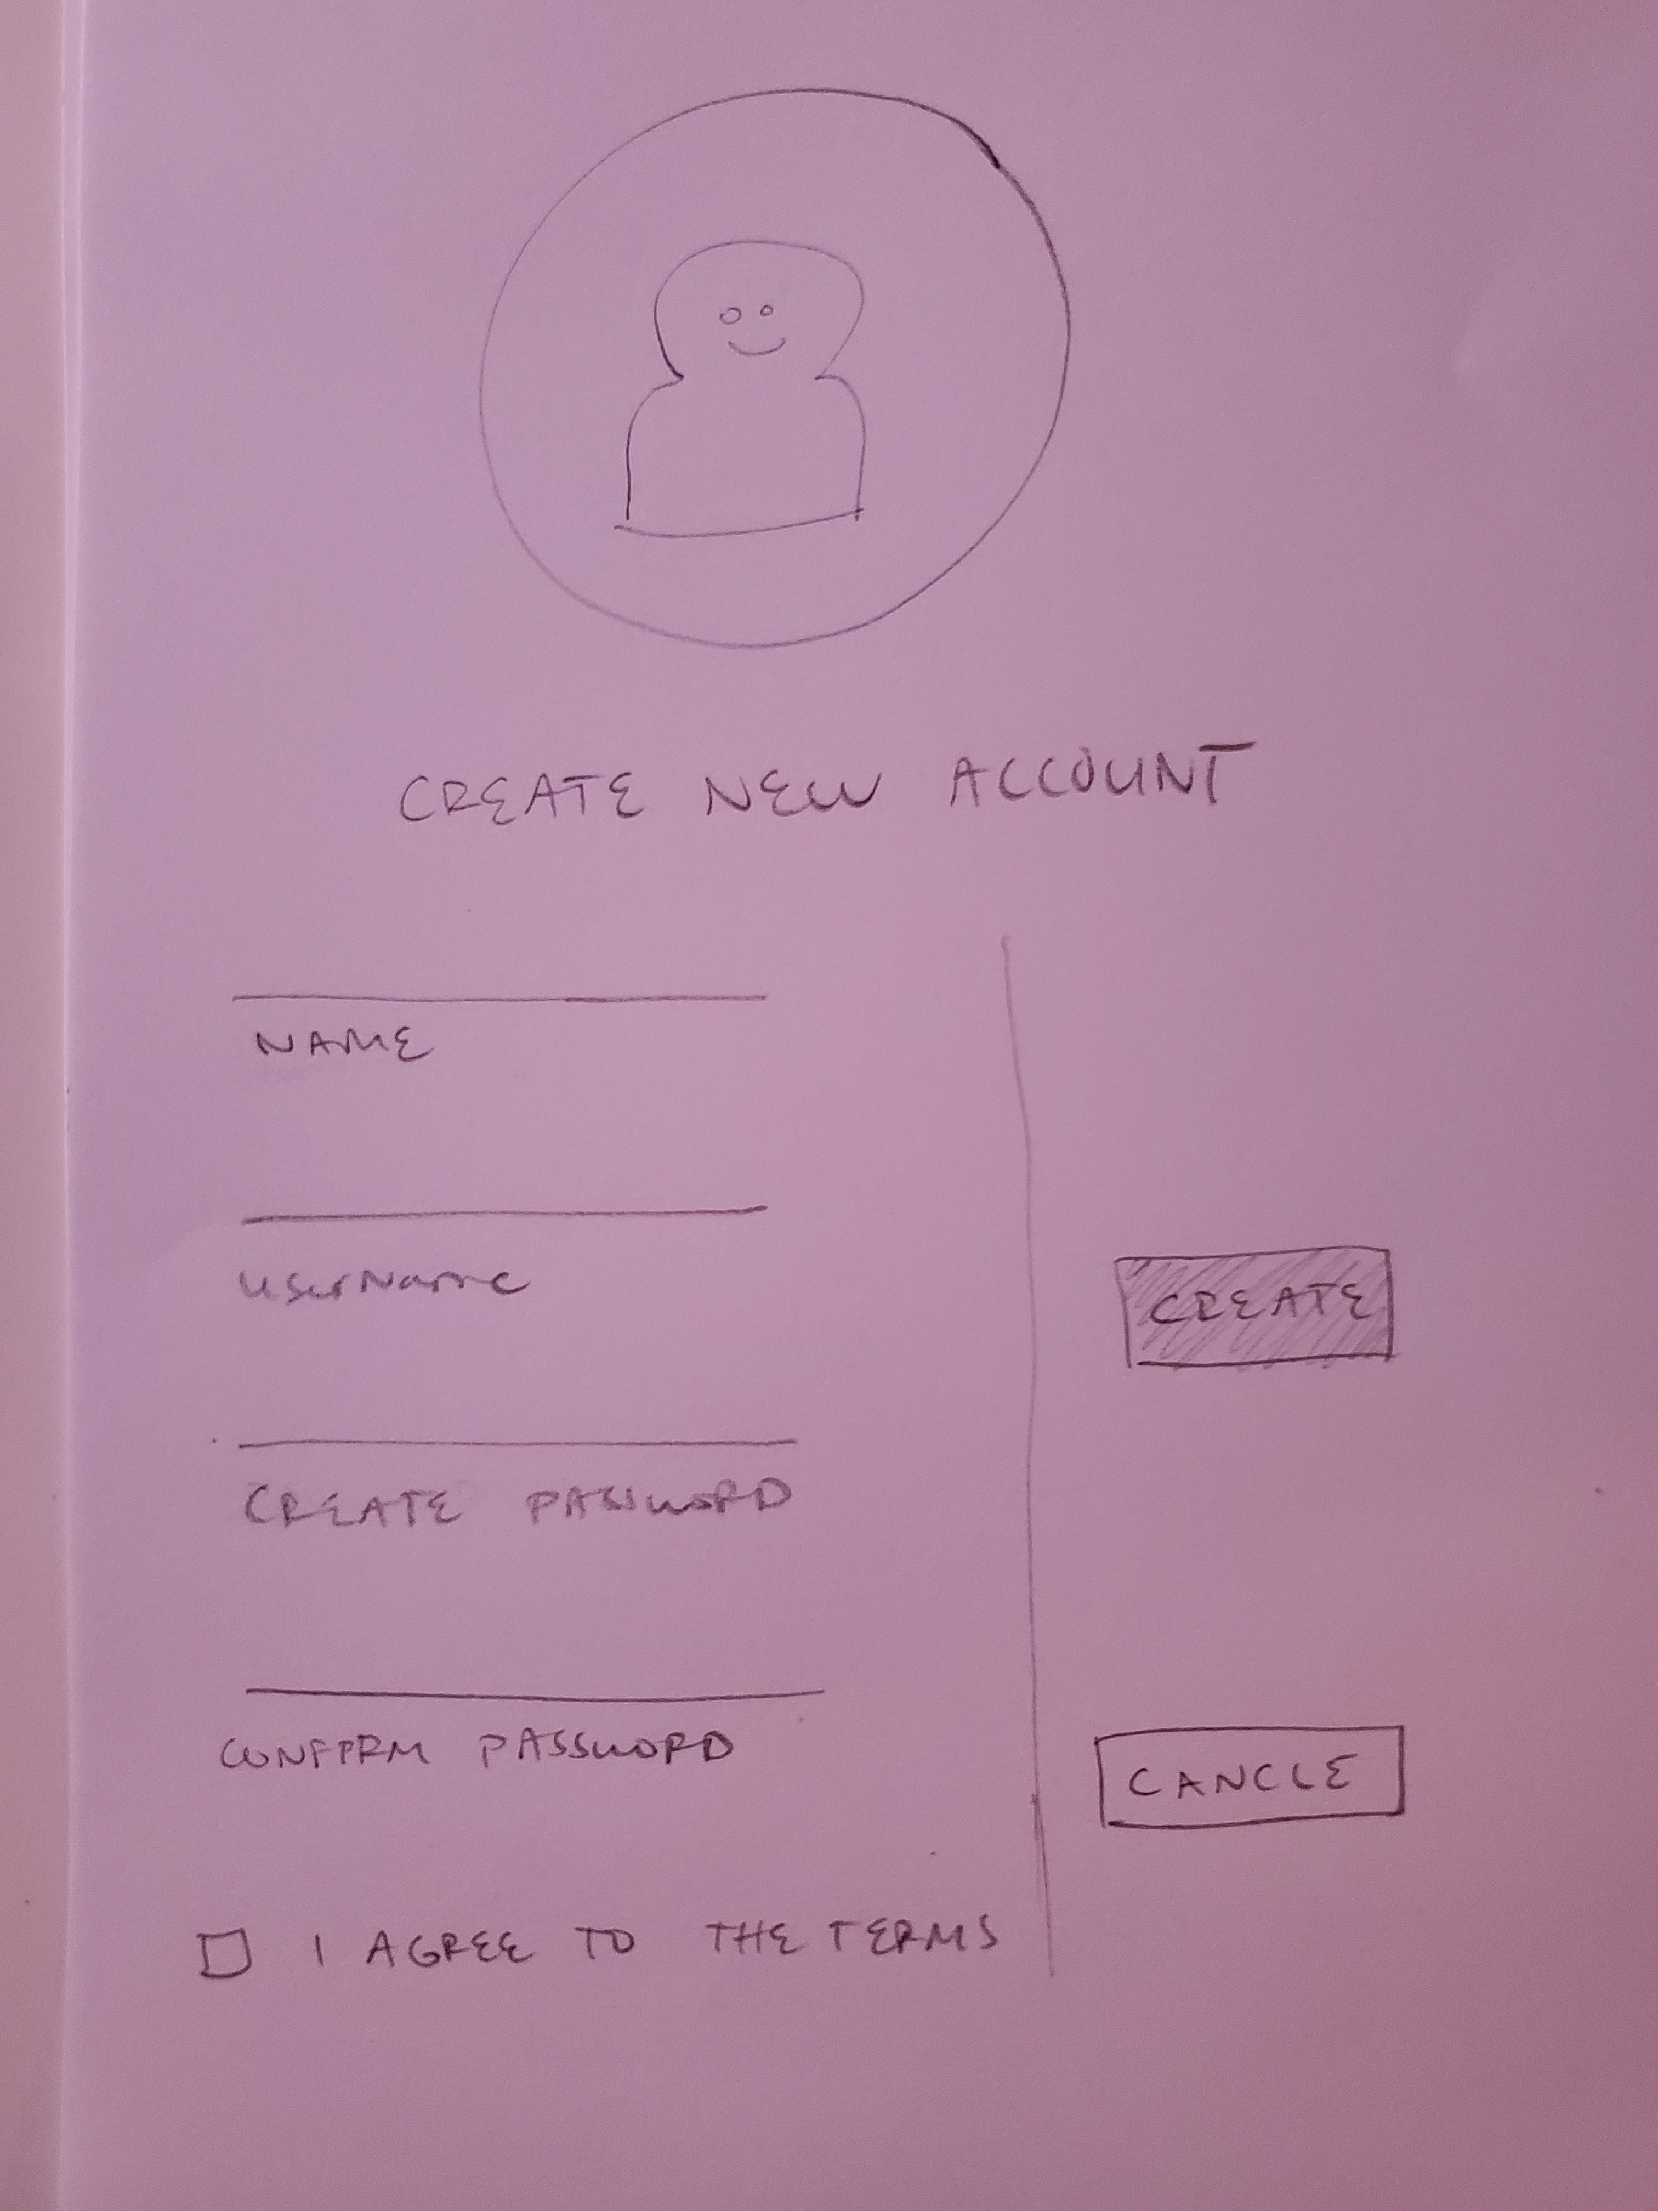
AdMINistrator Only - Prototype of User interface
Admin Creates new Account

Slide 20

Thank You

